Slide 1

Opeg Sri-uthaisiriwong
2465232
BE31003 coursework

Slide 2
Initial ideas
analysis of the accuracy of the mainstream CGM brands such as Dexcom, Freestyle Libre.
Use MARD of each brands to do the analysis

Slide 3
Problem with initial idea
There is not much analysis that I could do with MARD values other than comparing it to the other brands.
MARD values are only used for a quick comparison of the approximate accuracy and will not give any meaningful information as mentioned by L. Heinemann et. Al [1]
Companies and research papers will not provide raw data because they are confidential to the patients.

Slide 4
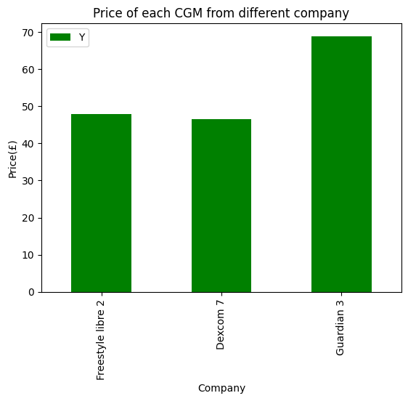
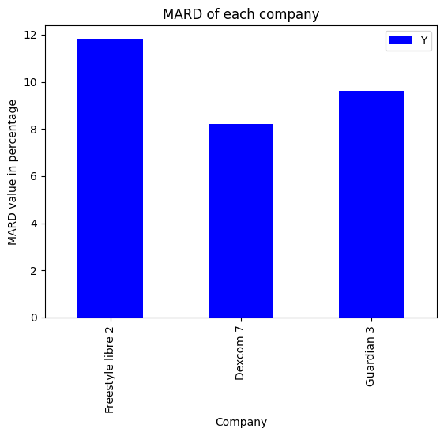
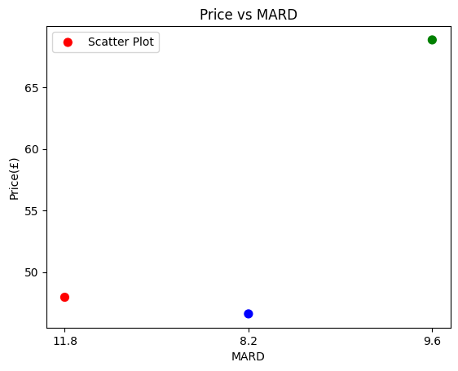
Results
As shown, the analysis does not provide much valuable insight on the CGM
This analysis only provide a quick comparison of the companies

Slide 5
Final idea
Find and compare the difference between the blood glucose over time of diabetic and non-diabetic person using various tests
Goal: to find the possible key difference between diabetic and non-diabetic patients that could be used as a hint to predict whether someone has diabetes or not.
main hypothesis: there is a significant amount of different between the blood glucose level of people with diabetes and without.

Slide 6
Data used
The mean BG data overtime of diabetic patients were calculated and used as a representation of BG overtime of diabetic patients.
The mean BG data overtime of non-diabetic patients were also calculated and used as a representation of BG overtime of non-diabetic patients.

Slide 7



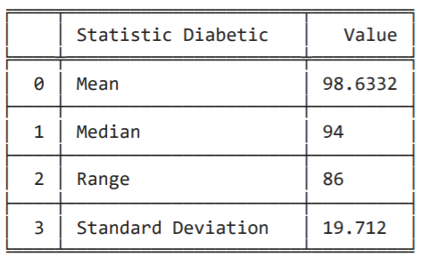
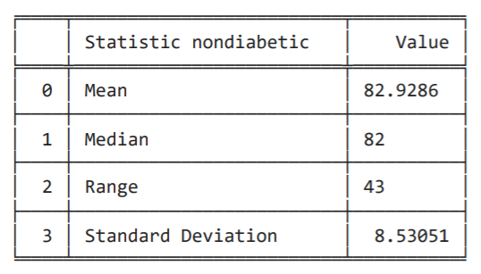
Results

Slide 8
Result analysis
From the tables in slide 6, the data showed that there are significant difference between the mean, median, range, and S.D of the blood glucose level of patients with diabetes and no diabetes.
The two-tailed and Cohen's d test confirmed that the assumption was correct.
The difference in mean shows that the average BG level of the patients with diabetes and no diabetes are different, with patients with diabetes having higher average BG level.
The range shows how patients with diabetes will have a higher spike of BG level when after consuming food.
The S.D shows how patients with diabetes have a more unstable BG level and how their BG level fluctuates more than patients without diabetes.

Slide 9
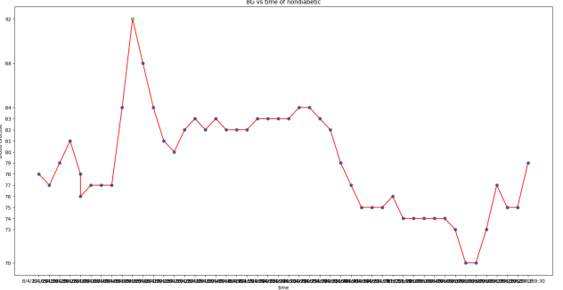
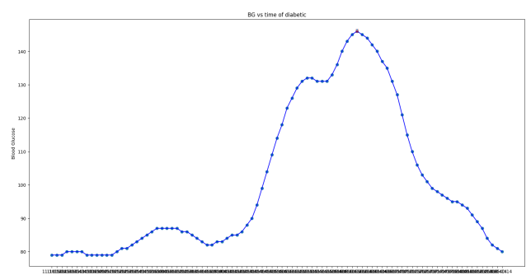
Result of BG vs time graph

Slide 10
Result analysis
The spike in the BG level of the patients with diabetes after consuming is much higher compared to those with no diabetes
This could be one of the signals to look out for when trying to diagnose whether someone has diabetes or not. However, looking at the peak and the steepness of the climb will not be sufficient for diagnosis, and many more tests will be needed. Other factors such as other health complications could also affect the BG level so this analysis must be taken with caution.
The graph also shows the basal BG level to be different between patients with diabetes and no diabetes, which could be another sign that corelates with diabetes.

Slide 11

Conclusion
From the analysis, one can use CGM to speculate whether they have diabetes or not.
Though the analysis shows that the BG level readings, mean, median, mode, and S.D of the patients with diabetes and no diabetes to be significantly different, it can only be use for a speculation and cannot be used to diagnose someone with diabetes.
More sophisticated tests such as A1C, fasting blood sugar, glucose tolerant, and more tests must be used to diagnose someone with diabetes according to CDC [2]

Slide 12
reference
[1] L. Heinemann et al., “Benefits and Limitations of MARD as a Performance Parameter for Continuous Glucose Monitoring in the Interstitial Space,” Journal of Diabetes Science and Technology, vol. 14, no. 1, pp. 135–150, Jun. 2019, doi: https://doi.org/10.1177/1932296819855670.
[2] CDC, “Diabetes Tests,” Centers for Disease Control and Prevention, Feb. 28, 2023 https://www.cdc.gov/diabetes/basics/getting-tested.html
‌

